Slide 1
WEATHER PREDICTION AND
ACCURACY COMPARISON OF
DIFFERENT CLASSIFICATION MODELS
KIRTPREET KAUR
B.E. CSE 2ND YEAR
CHANDIGARH UNIVERSITY
MENTOR- Ms. URVASHI NAG

Slide 2
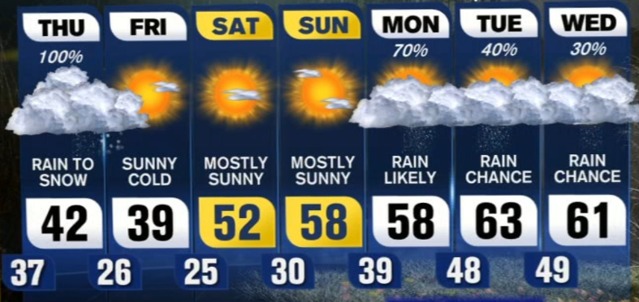
Weather affects nearly every aspect of our lives, from our food sources to our transport infrastructure, from what clothes we wear, to where we go on holiday. It has a huge effect on our livelihoods, our
health, and our future.
Thus, it’s important that we understand the accurate type of weather, so that we can prepare for the entire day.
Studying the weather helps us predict how much rain the next winter might bring, or how far sea levels will rise due to warmer sea temperatures.
We can also see which regions are most likely to be affected by extreme weather, or which wildlife species are threatened by climate change.

Slide 3
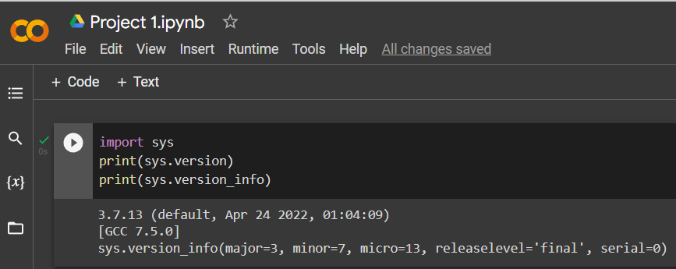
SOFTWARE USED-
GOOGLE COLAB
NOTEBOOK
VERSION- 3.7.13
MS EXCEL
HARDWARE REQUIREMENTS- WORKS ON ANY
DEVICE THAT HAS A GOOD INTERNET CONNECTION,
MODEL 2013 AND LATER

Slide 4
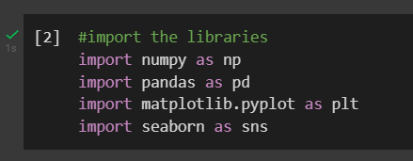
CODE AND EXPLANATION
LIBRARIES
pandas-
Helps working
with datasets
matplotlib-
Helps to work with
graphs and plots
seaborn-
It also helps in
working with plots,
kind of advanced
version of
matplotlib
Here, in this piece of code we are importing various libraries required for the successful execution of the project, like pandas, matplotlib.pyplot and seaborn.

Slide 5

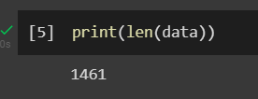
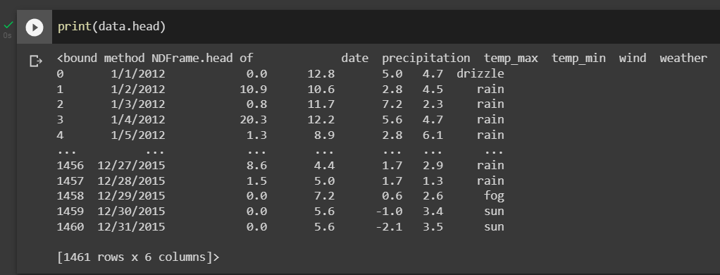
Loading the dataset
onto the notebook
Printing the length of the dataset i.e.
number of rows the dataset contains
Printing the
top six rows
of the dataset

Slide 6
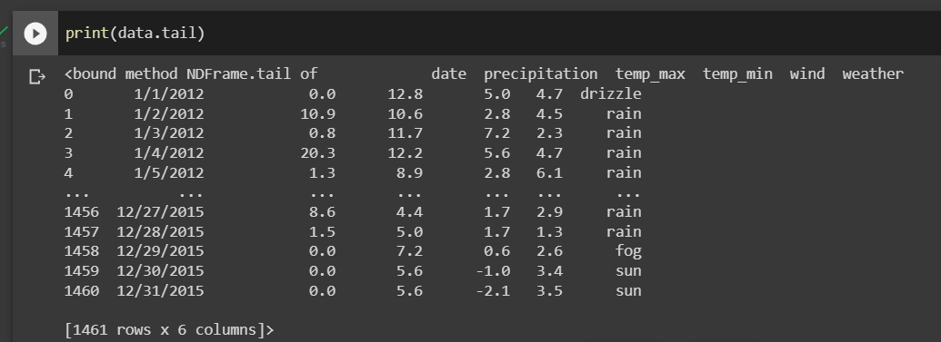
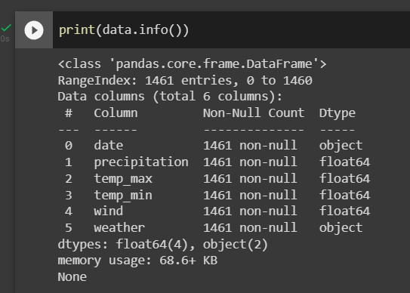
Printing the
last six rows
of the dataset
Printing the information of the dataset like
Rows: 1461, Columns: 6
Column names and data types, null values and memory used

Slide 7
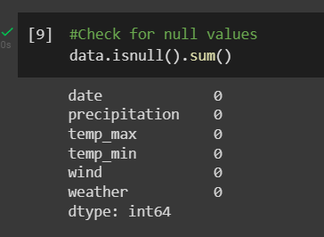

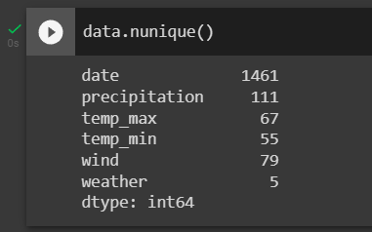
Checking for the null values in the dataset using isnull command. But according to the data we don’t have a null value in any of the data.
Now we need to convert date using datetime command in order to check for the distinct values.
The nunique () function is used to count distinct observations over requested axis and return series with number of distinct observations.

Slide 8
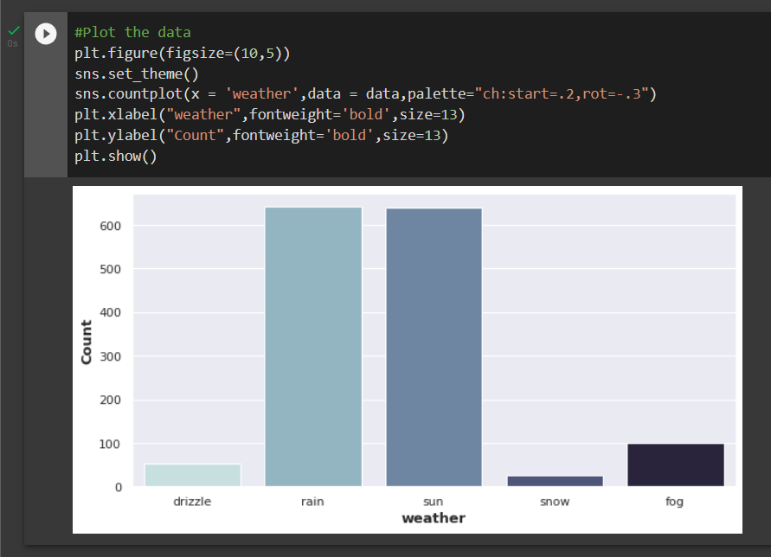
Plotting a graph
between number of
days and weather
where the weather
was sunny or rainy
for maximum of
days, almost 650-650,
totaling to 1300,
fog was for about
100 days, drizzle
was for around 50
days and snow for
about 10 days

Slide 9
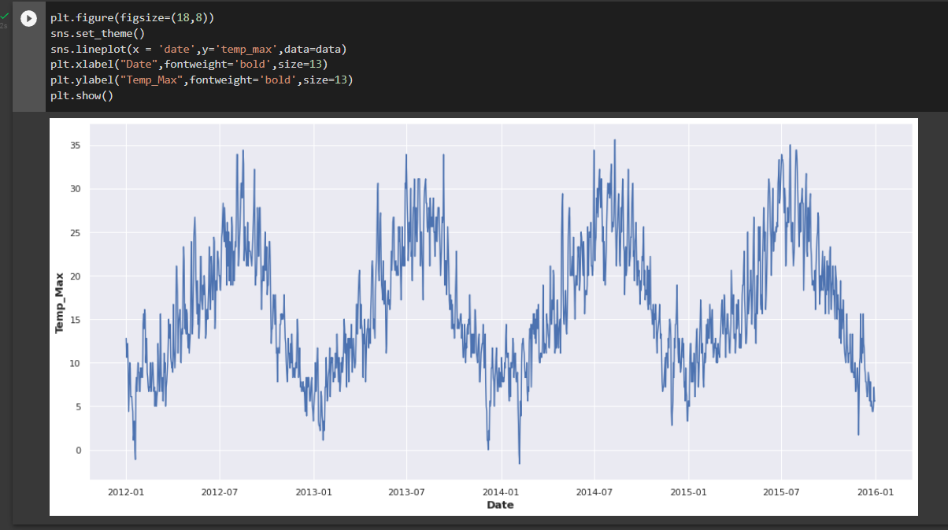
Plotting a graph between
Maximum Temperature and Date

Slide 10
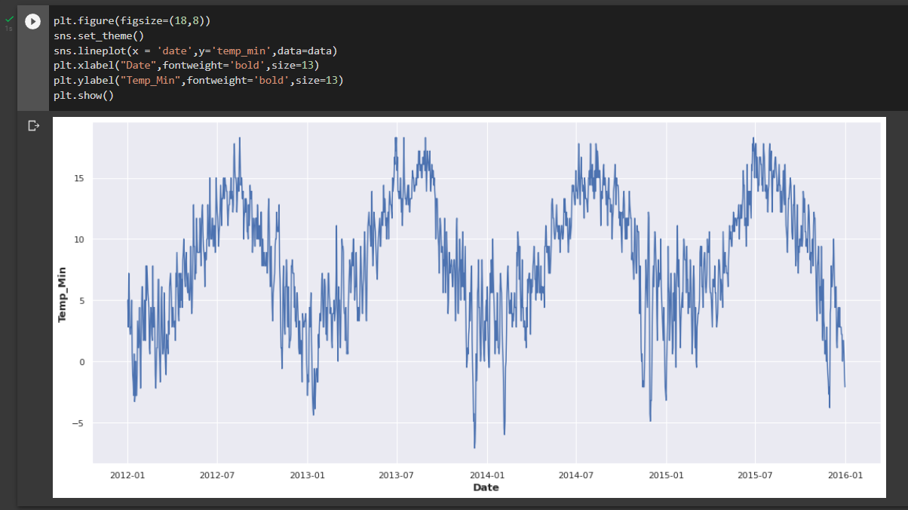
Plotting a graph between
Minimum Temperature and Date

Slide 11
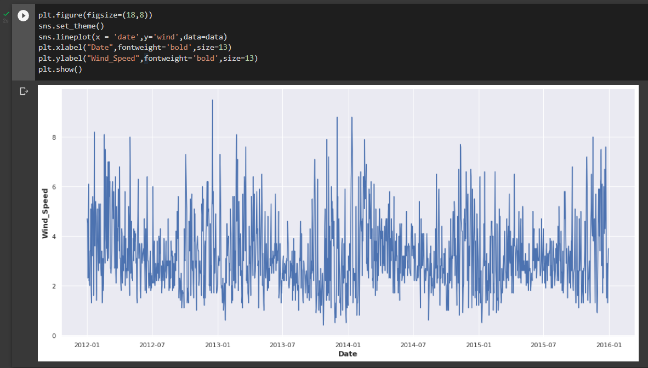
Plotting a graph between
Wind Speed and Date

Slide 12
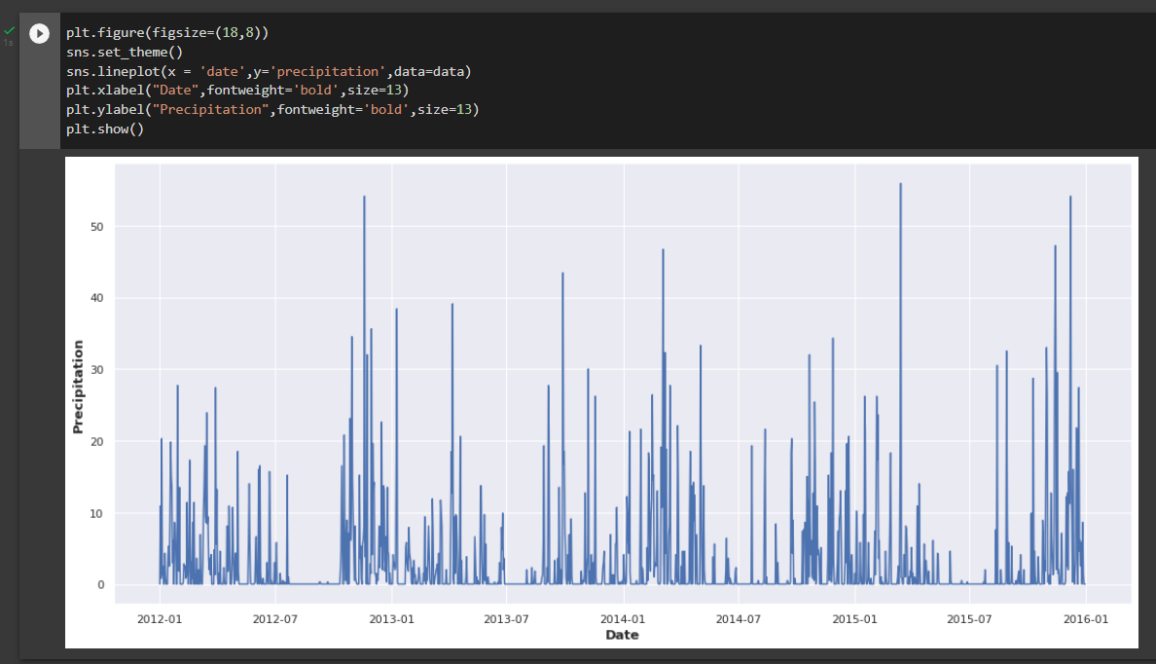
Plotting a graph between
Precipitation and Date

Slide 13
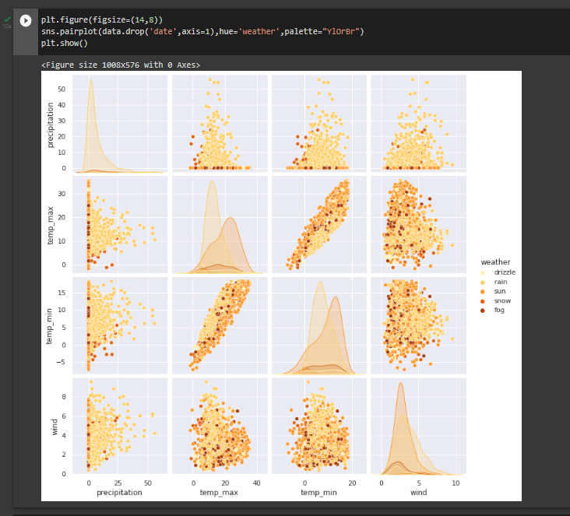
Here, we are
dropping date and
then making a
pair plot, which
helps in making a
comparison in
data having both
categorical and
numerical values

Slide 14
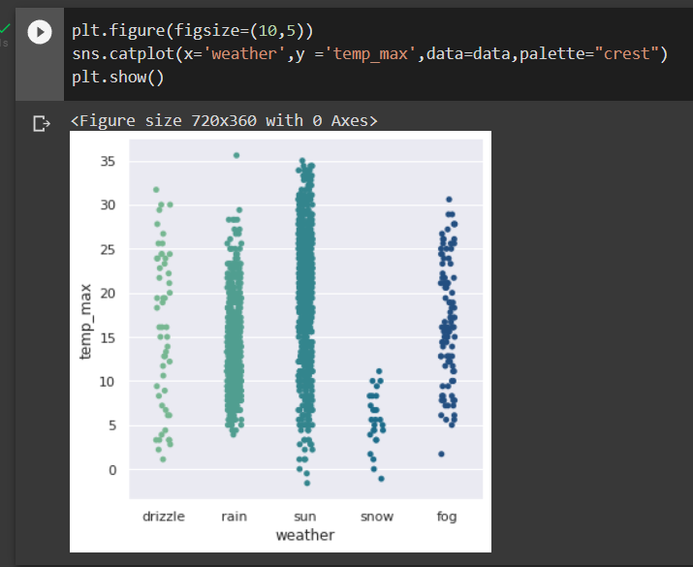
A catplot between
maximum
temperature
and different
weather days

Slide 15
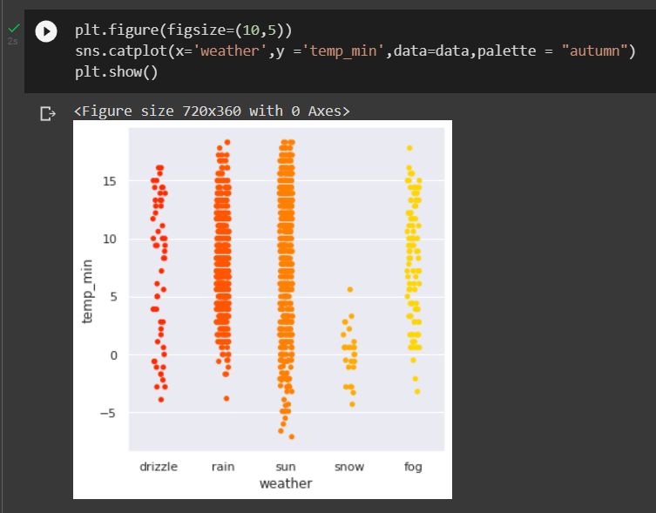
A catplot between
minimum
temperature
and different
weather days

Slide 16
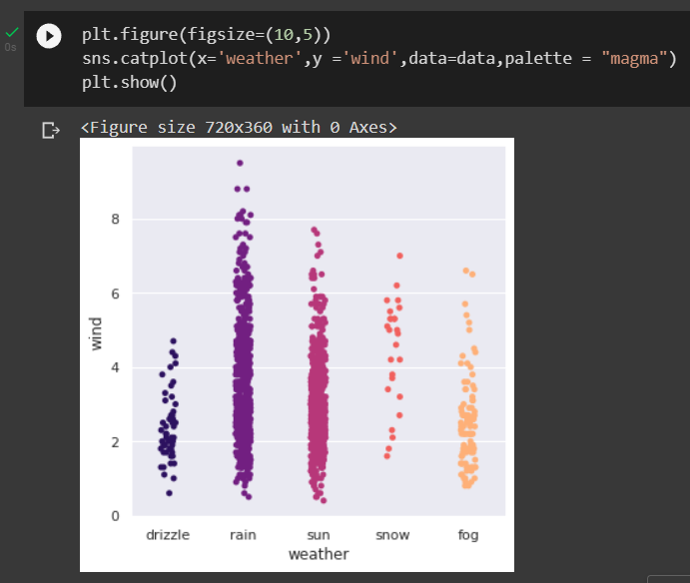
A catplot between
Wind speed
and different
weather days

Slide 17
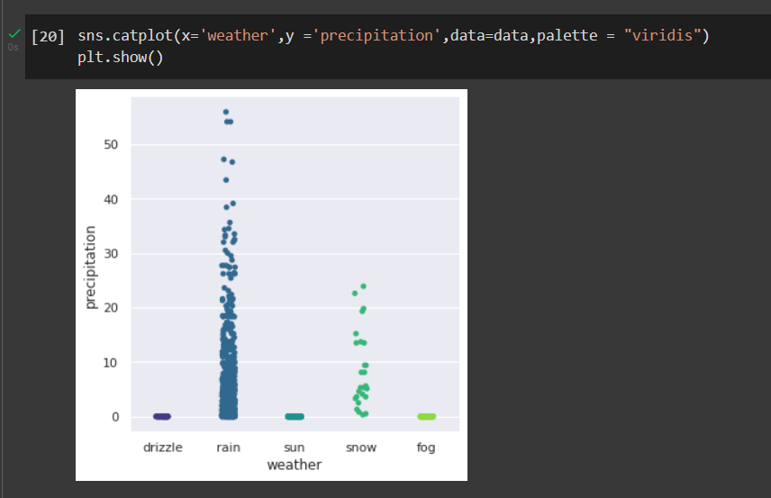
A catplot
between
precipitation
and
different
weather
days

Slide 18
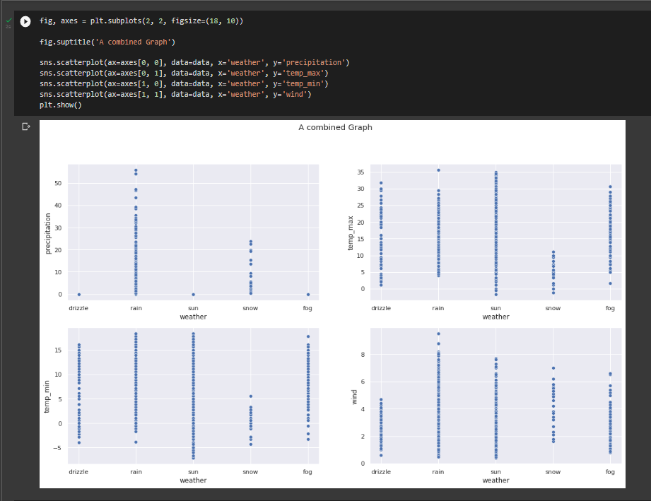
Relation between
different plots
with weather
conditions when it comes to maximum
and minimum
temperatures,
Wind speed and
Precipitation

Slide 19
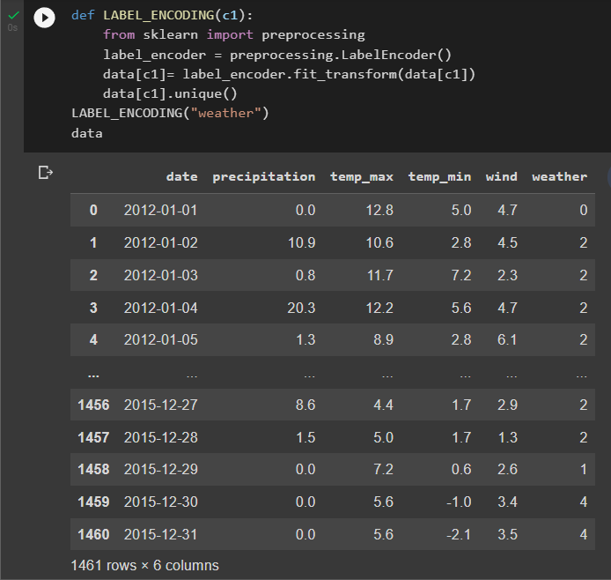
Here we have created a
function LABEL_ENCODING
and then from sklearn library, we are importing
preprocessing which refers to the transformations applied on the code and then after the applied transformation, we have printed the dataset.

Slide 20


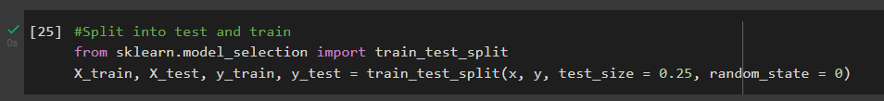
Here we have dropped the date to change our categorical data into numerical data
Here we have split the data into train and test where 75% is for training and 25% for testing

Slide 21
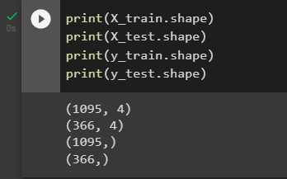
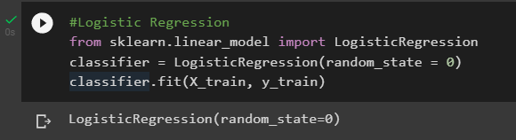
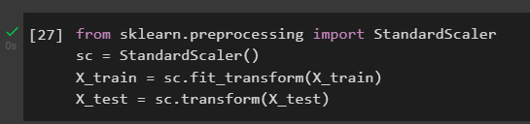
Here we have printed the shape i.e. the dimensions of the training and testing datasets
Here we have used logistic regression classifier to test and train the model
Here we have imported standardscaler from sklearn and specified variables for the train and tested

Slide 22
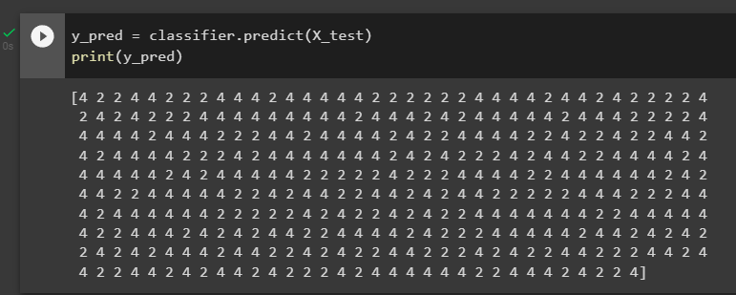
Here we are working on the test data to predict the required output
In this piece of code we have imported confusion matrix and accuracy score from sklearn library

Slide 23
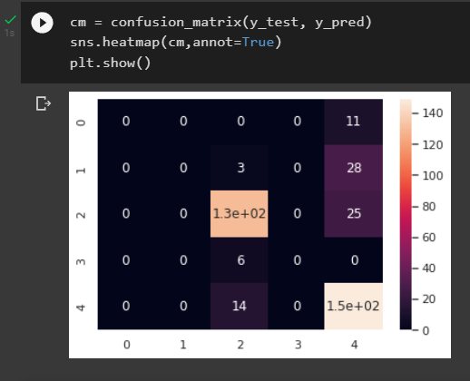
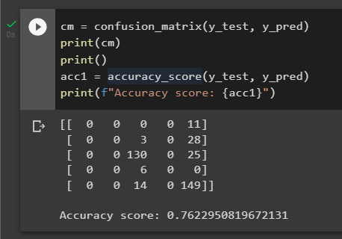
Here we have plotted a confusion matrix in the form of a heatmap
Here we have made a confusion matrix and calculated the accuracy of Logistic Regression

Slide 24
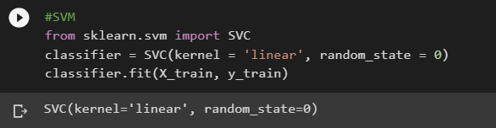
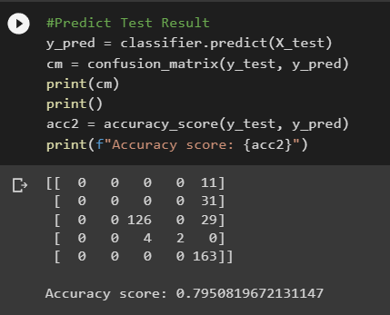
Here we have used svm classifier by importing svc from sklearn library to test and train the model
Here we have made a confusion matrix and calculated the accuracy of SVM classifier

Slide 25
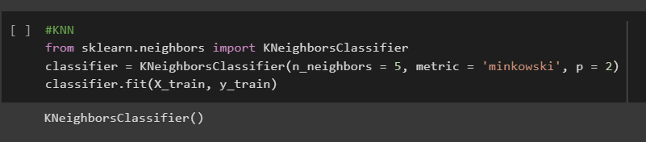
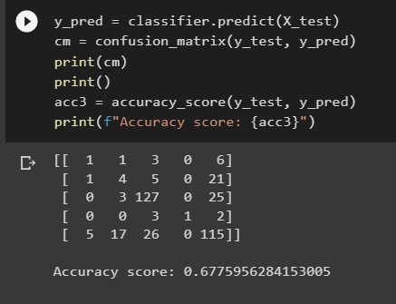
Here we have used KNN classifier by importing KneighborsClassifier from sklearn library to test and train the model
Here we have made a confusion matrix and calculated the accuracy of KNN classifier

Slide 26
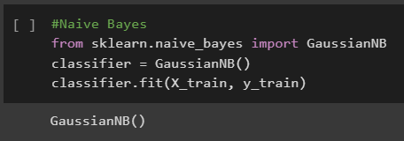
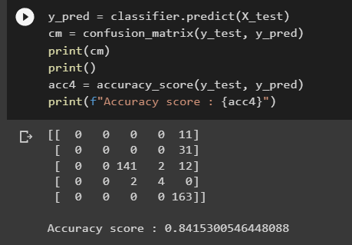
Here we have used Naive Bayes classifier by importing GaussianNB from sklearn library to test and train the model
Here we have made a confusion matrix and calculated the accuracy of Naive Bayes classifier

Slide 27
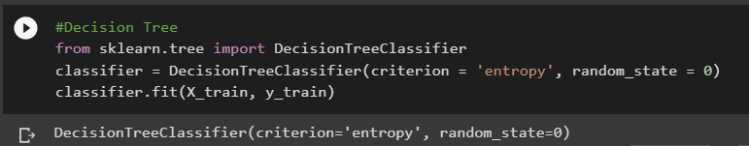
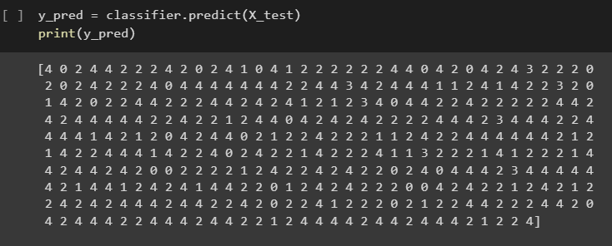
Here we have used Decision Tree classifier by importing DecisionTreeClassifier from sklearn library to test and train the model
In this part we have predicted the testing data to get the desired output

Slide 28
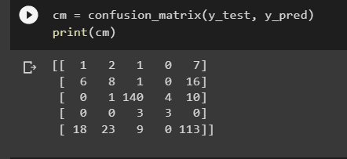
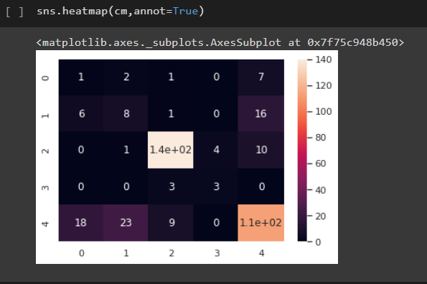
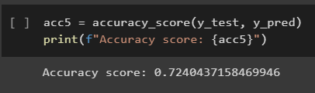
We have made a confusion matrix in this part of code
Here we have plotted a confusion matrix in the form of a heatmap
Here we have calculated the accuracy of the Decision Tree classifier

Slide 29
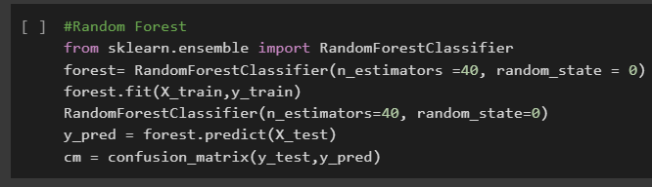
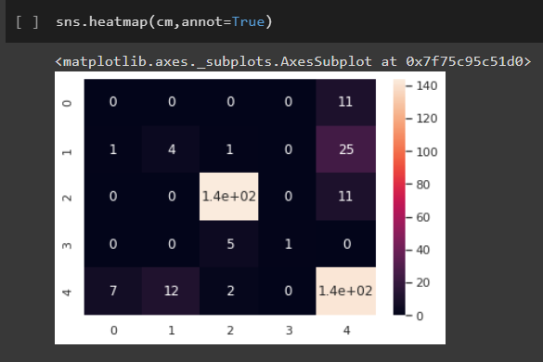
From sklearn library we have imported random forest classifier and then classified the data into train and test
Here we have plotted a confusion matrix in the form of a heatmap

Slide 30
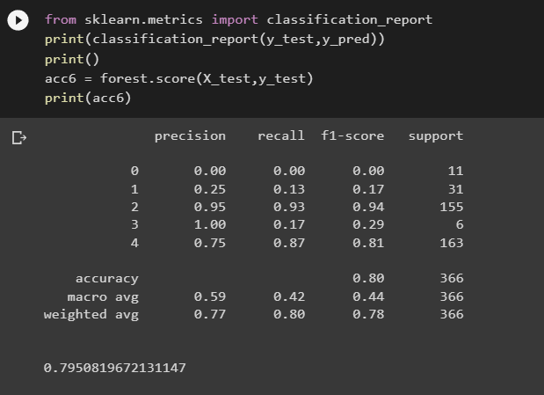
Here we have calculated the detailed report and the accuracy of the data classified by
Random Forest Algorithm

Slide 31
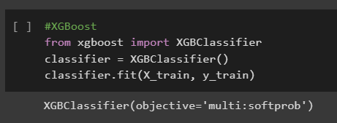
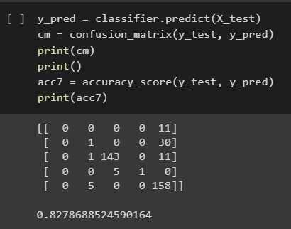
Here we have imported xgboost classifier from the library and then classified the data into train and test
Now, we make its confusion matrix and find out the accuracy

Slide 32
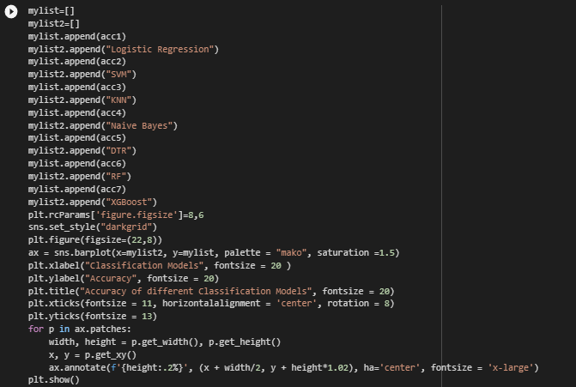
In this part of code, we have plotted the values of accuracy of different classification models

Slide 33
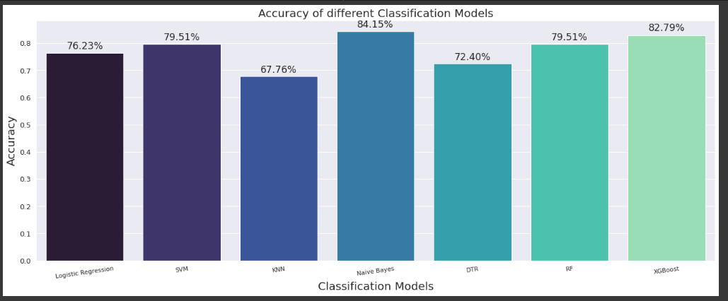

Slide 34
RESULT AND CONCLUSION
After working on various weather conditions at different days using seven different algorithms i.e. LOGISTIC REGRESSION, SVM, KNN, NAÏVE BAYES, DECISION TREES, RANDOM FOREST and XGBOOST, we conclude that the accuracy of the conditions predicted by Naïve Bayes is most with around 84% accuracy while KNN gives least accurate results with the accuracy around 68%.

Slide 35
FUTURE SCOPE
This project gave an idea on what algorithm should be preferred in order to get most accurate results when it comes to weather prediction, which if enhanced properly can provide great results. It can help reduce the false weather predictions to much extent and better understanding of the data.

Slide 36


